Slide 1
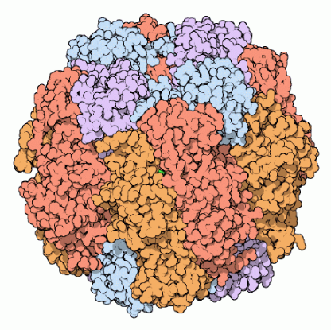
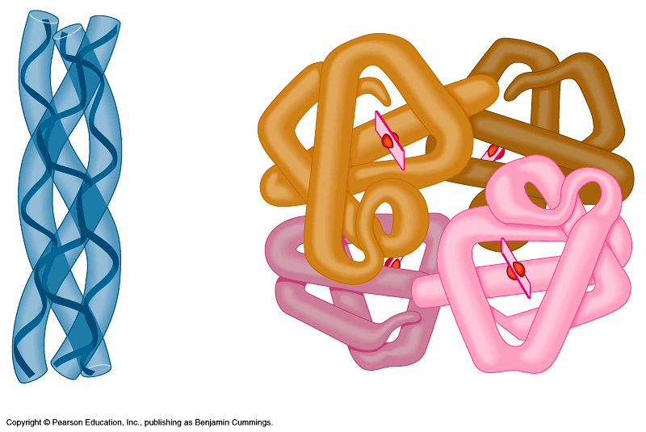
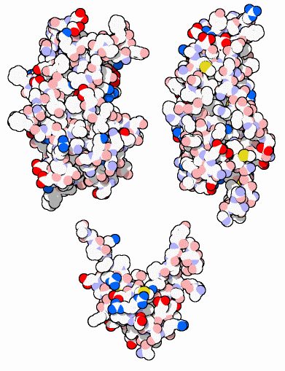
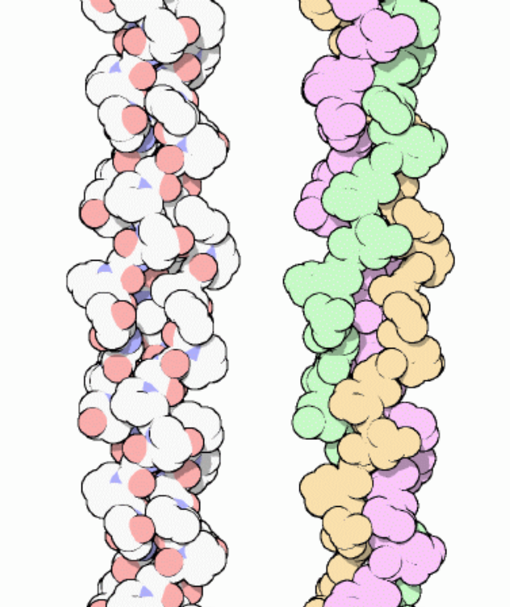
Proteins
Multipurpose
molecules
2006-2007
Notes:
clockwise:
Rubisco — most important protein on the planet?
Hemoglobin — a red blooded protein :-)
Collagen — strings you together
Growth Hormones — working hard in you right now!

Slide 2
Proteins
Most structurally & functionally diverse group of biomolecules
Function:
  involved in almost everything
    Metabolism
    Support
    Transport
    Regulation
    Motion
Notes:
Storage: beans (seed proteins)
Movement: muscle fibers
Cell surface proteins: labels that ID cell as self vs. foreign
Antibodies: recognize the labels
ENZYMES!!!!

Slide 3
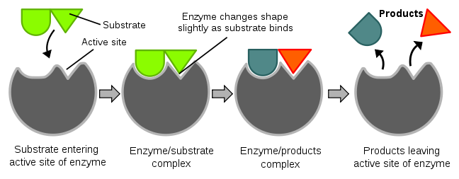
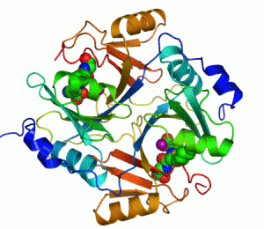
Metabolism
Enzymes
  Biological catalysts – speed up chemical reactions
    Digestive enzymes aid in hydrolysis
        Lipase
        Amylase
        Lactase
        Protease
    Molecular Biology
        Polymerase
        Ligase
    Industry
        Dairy, baby food, rubber, beer, photography, contact lense cleaner

Slide 4
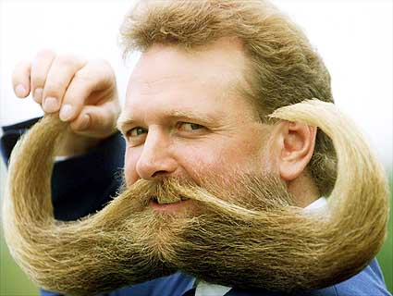
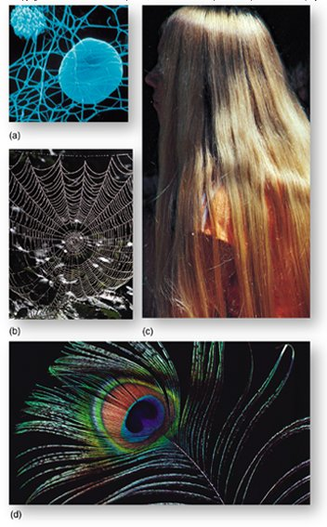
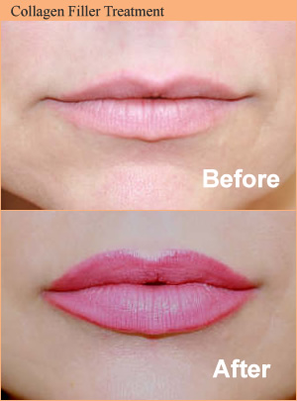
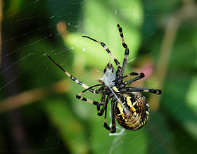
Support
Structural proteins
  Keratin – hair and nails
  Collagen – supports ligaments, tendons, and skin
  Silk – cocoons and spider webs

Slide 5
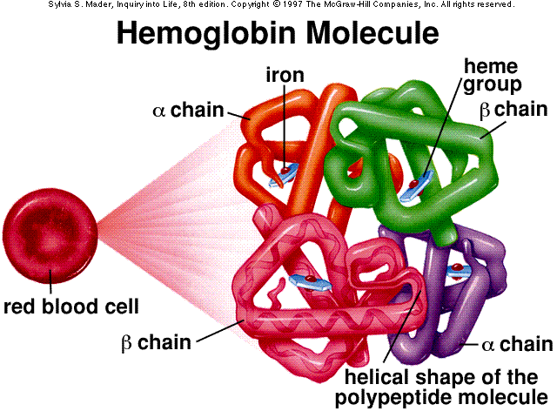
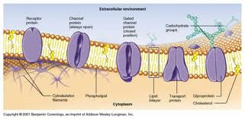
Transport
Channel and carrier proteins in the cell membrane
  Allows substances to enter and exit the cell
Transport molecules in blood
  Hemoglobin – transports oxygen in the blood

Slide 6
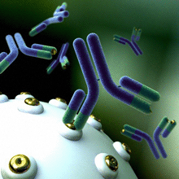
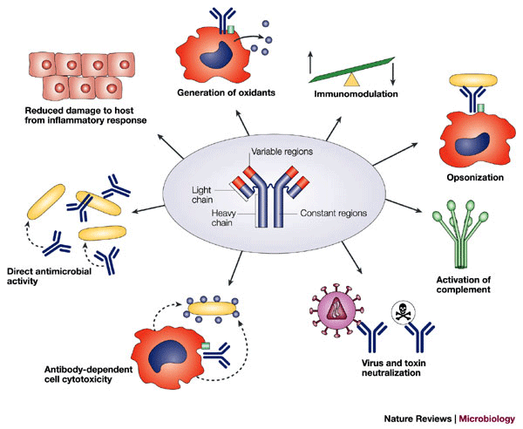
Defense
Antibodies
  Combat bacteria and viruses

Slide 7
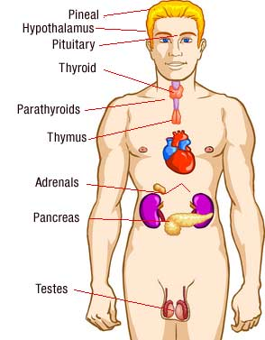
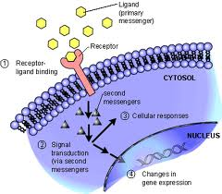
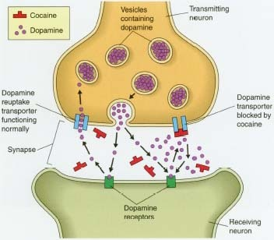
Regulation
Hormones
  Intercellular messengers that influence metabolism
  Insulin – regulates the amount of glucose in the
  blood and in cells
  Human growth hormone – its presence determines
  the height of an individual
Receptor Proteins
  Built into the membranes of nerve cells
  Detect chemical signals (neurotransmitters)
  released by other nerve cells

Slide 8
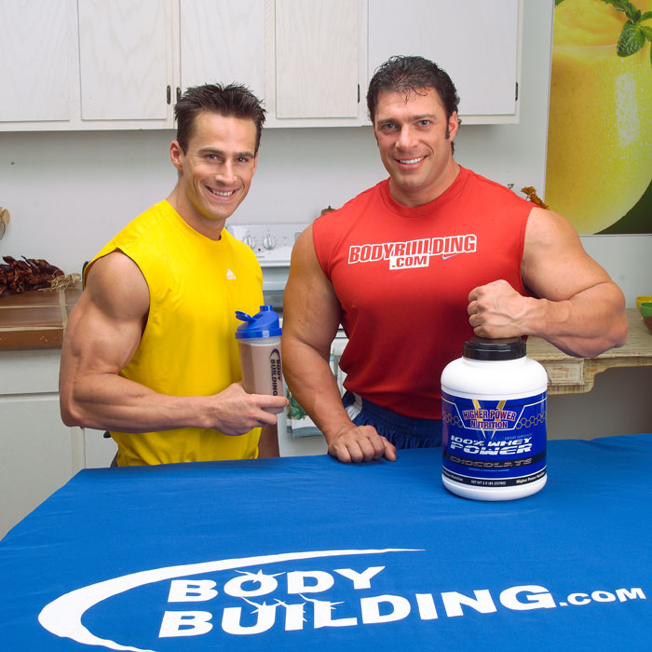
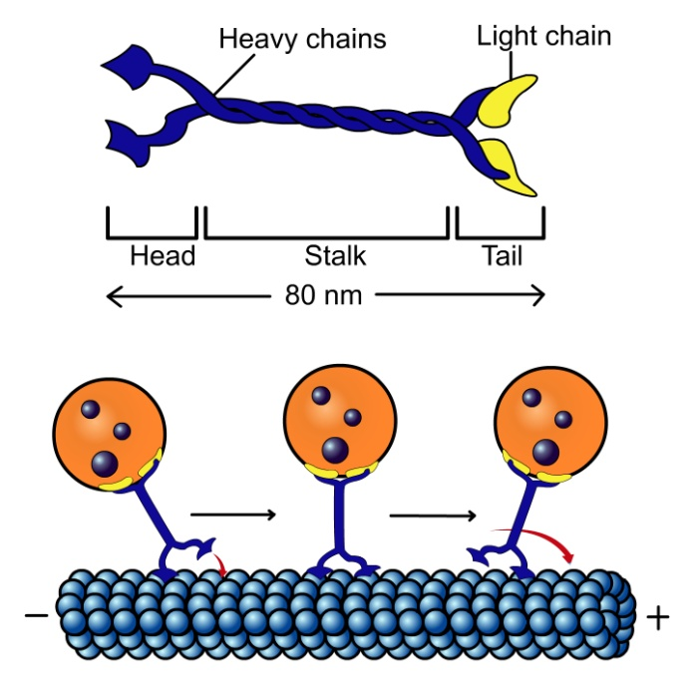
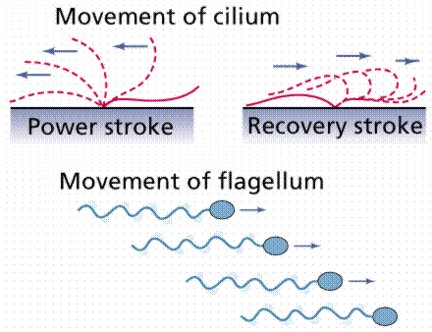
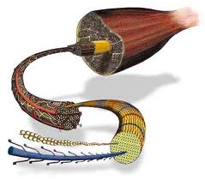
Motion
Muscle contraction
  Actin and myosin – make up muscle fibers
Motor proteins within the cell
  Allow cell components to move from place to place
  Flagella- move the cell
  Cilia- move contents around the cell

Slide 9
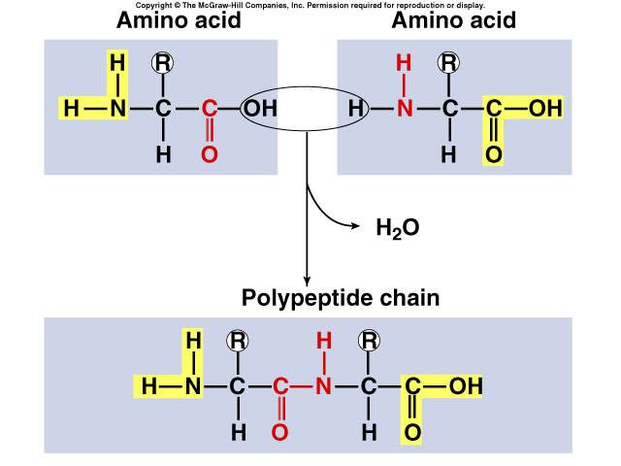
Proteins
Structure:
  monomer = amino acids
    20 different amino acids
      12 made by body
      8 essential amino acids (must get from food)
  polymer = polypeptide
    protein can be one or more polypeptide chains folded & bonded together
    large & complex molecules
    complex 3-D shape
hemoglobin
Rubisco
growth
hormones

Slide 10
Amino acids
Structure:
  central carbon (α carbon)
  amino group
  carboxyl group (acid)
  R group (side chain)
    variable group
    confers unique
    chemical properties
    of the amino acid
H
O
|
—C—
|
H
||
C—OH
—N—
H
R

Slide 11
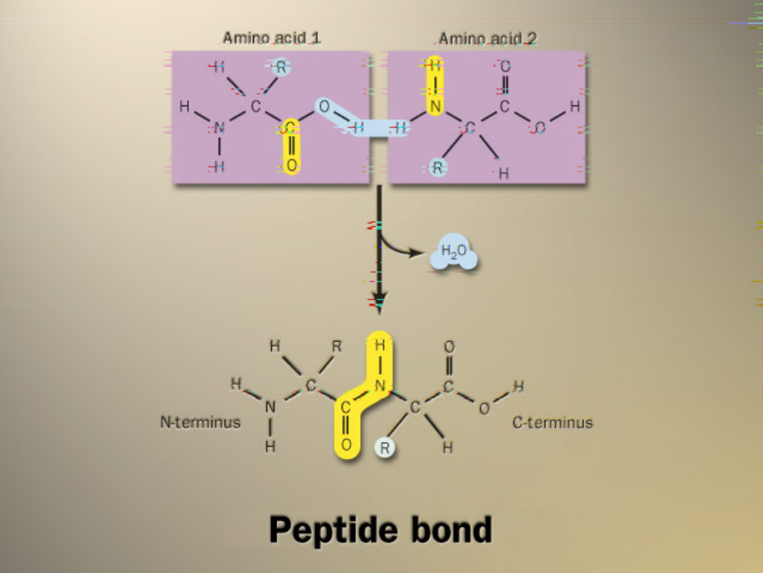
Building proteins
Peptide bonds
  linking NH₂ of one amino acid to
  COOH of another
  C–N bond
  N terminus – C terminus
dehydration synthesis
peptide
bond
Notes:
free COOH group on one end is ready to form another peptide bond so they “grow” in one direction from N-terminal to C-terminal

Slide 12
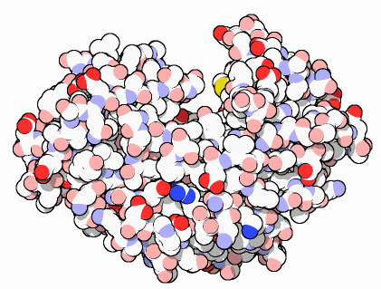
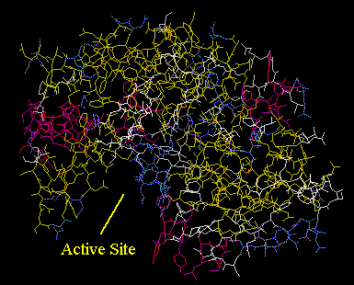
Protein structure & function
Function depends on structure
  3-D structure
    twisted, folded, coiled into unique shape
pepsin
hemoglobin
collagen
Notes:
Hemoglobin
Hemoglobin is the protein that makes blood red. It is composed of four protein chains, two alpha chains and two beta chains, each with a ring-like heme group containing an iron atom. Oxygen binds reversibly to these iron atoms and is transported through blood.
Pepsin
Pepsin is the first in a series of enzymes in our digestive system that digest proteins. In the stomach, protein chains bind in the deep active site groove of pepsin, seen in the upper illustration (from PDB entry 5pep), and are broken into smaller pieces. Then, a variety of proteases and peptidases in the intestine finish the job. The small fragments--amino acids and dipeptides--are then absorbed by cells for use as metabolic fuel or construction of new proteins.
Collagen– Your Most Plentiful Protein
About one quarter of all of the protein in your body is collagen. Collagen is a major structural protein, forming molecular cables that strengthen the tendons and vast, resilient sheets that support the skin and internal organs. Bones and teeth are made by adding mineral crystals to collagen. Collagen provides structure to our bodies, protecting and supporting the softer tissues and connecting them with the skeleton. But, in spite of its critical function in the body, collagen is a relatively simple protein.

Slide 13
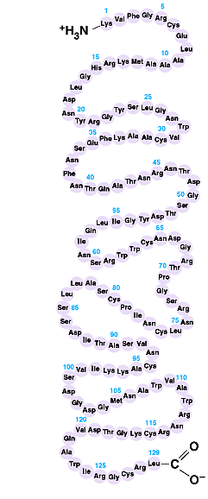
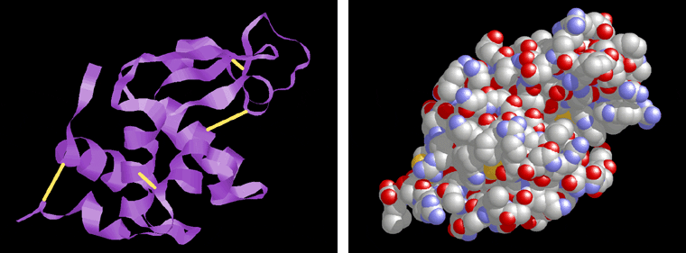
Primary (1°) structure
Order of amino acids in chain
  amino acid sequence determined by gene (DNA)
  slight change in amino acid sequence can affect protein’s structure & it’s function
    even just one amino acid change can make all the difference!
lysozyme: enzyme in tears & mucus that kills bacteria
Notes:
Sickle cell anemia: 1 DNA letter changes 1 amino acid = serious disease
Hemoglobin mutation: bends red blood cells out of shape & they clog your veins.

Slide 14
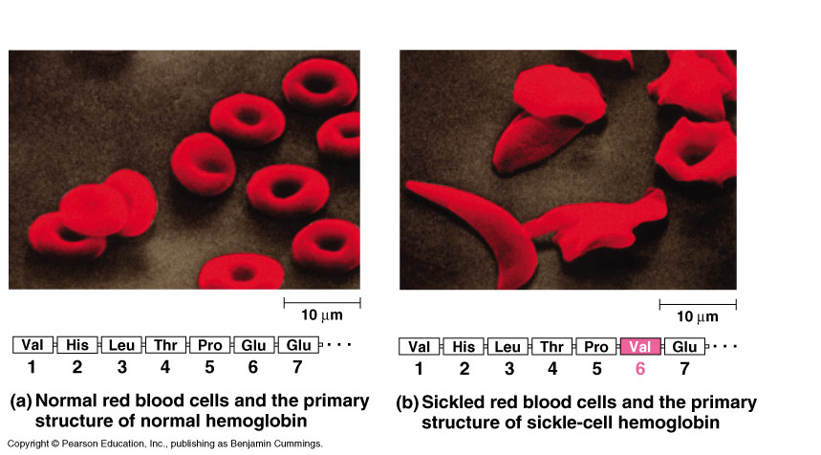
Sickle cell anemia
Notes:
glutamic acid is acidic & polar
valine is non-polar = tries to “hide” from water of cell by sticking to another hemoglobin molecules.

Slide 15
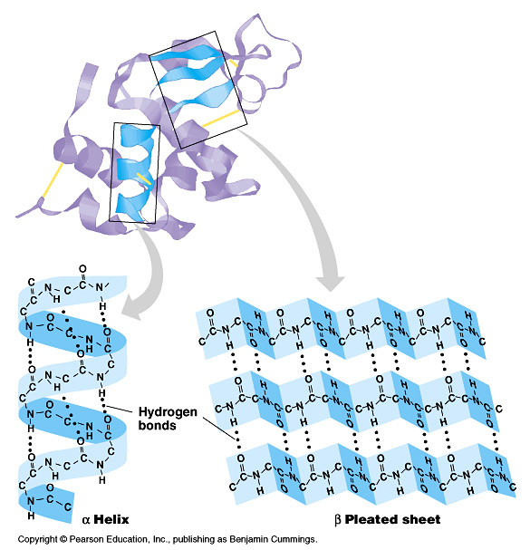
Secondary (2°) structure
“Local folding”
  folding along short sections of polypeptide
    interaction between adjacent amino acids
    H bonds between
    backbones (O:H)
    α-helix
    β-pleated sheet
    Fibrous proteins – only have secondary structure
      Keratin
      Silk
Notes:
It’s a helix or B sheet within a single region. Can have both in one protein but a specific region is one or another

Slide 16
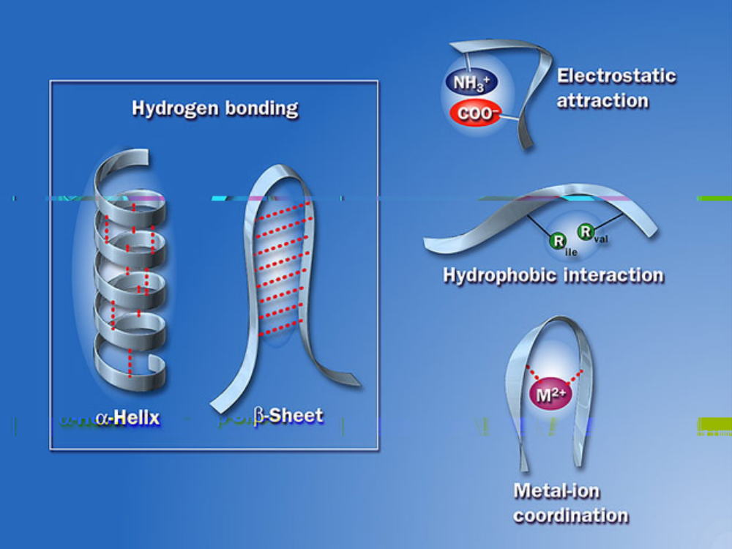
Secondary (2°) structure

Slide 17
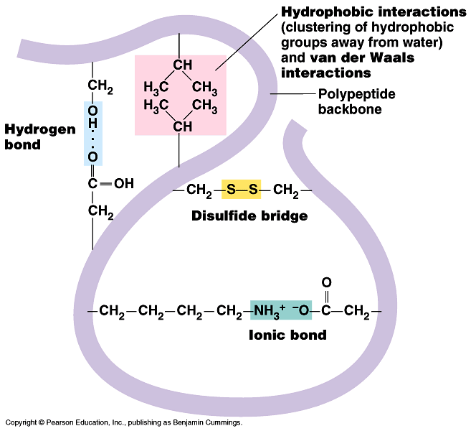
Tertiary (3°) structure
“Whole molecule folding”
  created when the secondary structure fold and form bonds to stabilize the structure into a unique shape
  determined by interactions
  between R groups
    Hydrophobic interactions
    anchored by
    disulfide bridges
    Ionic Bonds between R groups
    Hydrogen bonds between backbones
    Van der Waals Force (velcro)
      Globular (spherical) proteins – have tertiary structure
      enzymes
Notes:
How the whole thing holds together

Slide 18
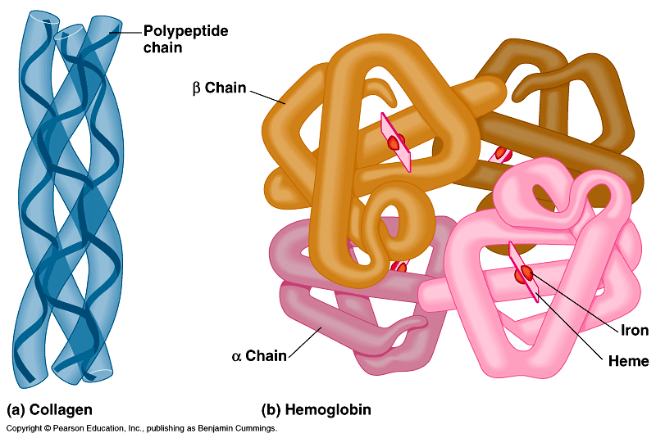
Quaternary (4°) structure
two or more tertiary folded peptide subunits bonded together to make a functional protein
  Hemoglobin – 4 polypeptides
  Collagen – 3 polypeptides
collagen =
skin & tendons
hemoglobin
Notes:
Structure equals function wonderfully illustrated by proteins
Collagen is just like rope -- enables your skin to be strong and flexible.

Slide 19
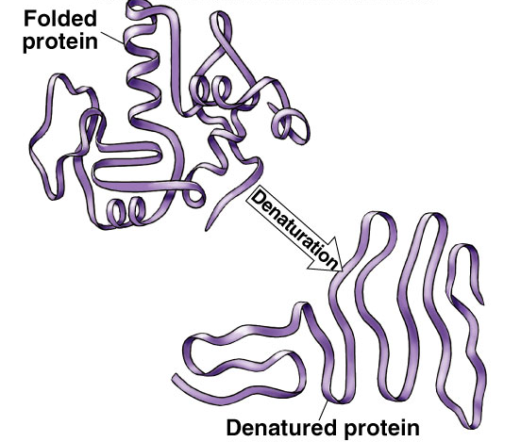
Denature a protein
Unfolding a protein/changes the shape
  disrupt 3° structure
    pH  temperature
  unravels or denatures protein
  disrupts H bonds, ionic bonds &
  disulfide bridges
  destroys functionality
Notes:
Example:
Eggs:
Cooking an egg permanently denatures the proteins.

